Slide 1
High-Throughput HSP in inkjet ink development
An overview

Slide 2
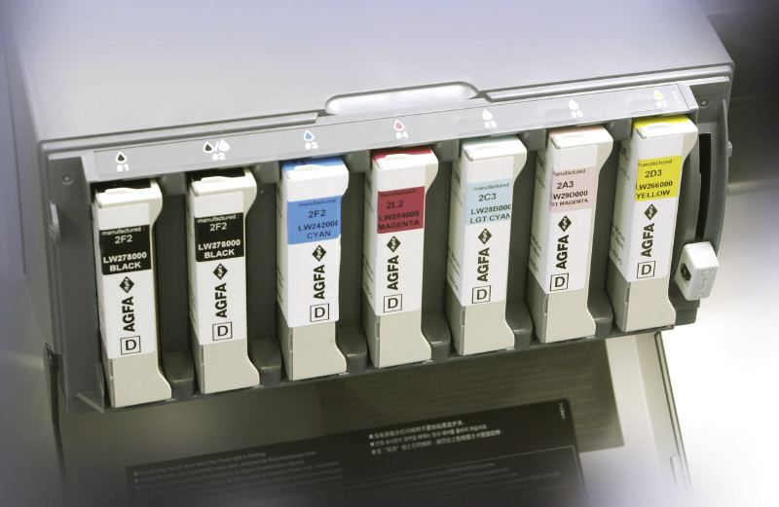
Inkjet ink design
Pigment dispersions
Color chemistry
Polymer chemistry
Colloid chemistry
Formulation
Rheology
(Nano)analytics
...

Slide 3
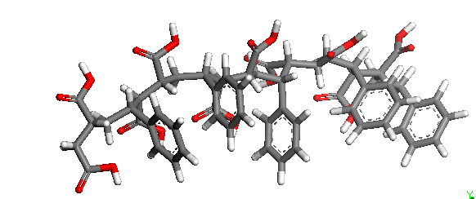
Which model ?
Atomistic modeling - molecular dynamic simulation
Coarse grain approach (polymer consists of a chain of parameterized beads) - dynamic simulation
(Hansen) Solubility parameter (polymer represented by a parameterized point) - simple mathematics
Accuracy
Complexity
CPU-time
Time to market is proportional to complexity of models used.
Experimental (HT) HSP determination is indispensable.

Slide 4
Which interactions are allowed ?
X
!
X
X
!
X
X
!
!
!
!

Slide 5
..and…which are not allowed
HOW CAN WE DISTINGUISH, SEPARATE AND QUANTIFY THE RELATIVE IMPORTANCE OF THESE DIFFERENT PHENOMENA BY ANALYTICAL TOOLS, SIMULATION TOOLS OR EXPERIMENTAL METHODS ?

Slide 6
Model for polymer-pigment-solvent interactions
δ_{p}
!
Matrixophilic part
of polymer
!
!
!
!
2δ_{d}
Pigment surface
δ_{h}
* Pigment and pigmentophilic polymer part must overlap: adhesion of the polymer to the pigment surface
* Pigment and matrixophilic polymer part may not overlap: collapsing of the stabilising polymer chains on the pigment surface
* Solvents may only be good solvents for matrixophilic polymer part otherwise competition with other interactions

Slide 7
How to qualify the interactions ?
Ra² = 4(δ_{D1} - δ_{D2})² + (δ_{P1} - δ_{P2})² + (δ_{H1} - δ_{H2})²
= weighted geometric distance between 2 components
RED = Ra / Radius
If RED < 1 : interaction !
Interactions can be easily calculated in an interaction table

Slide 8
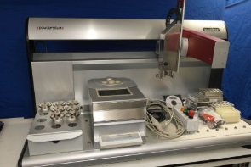
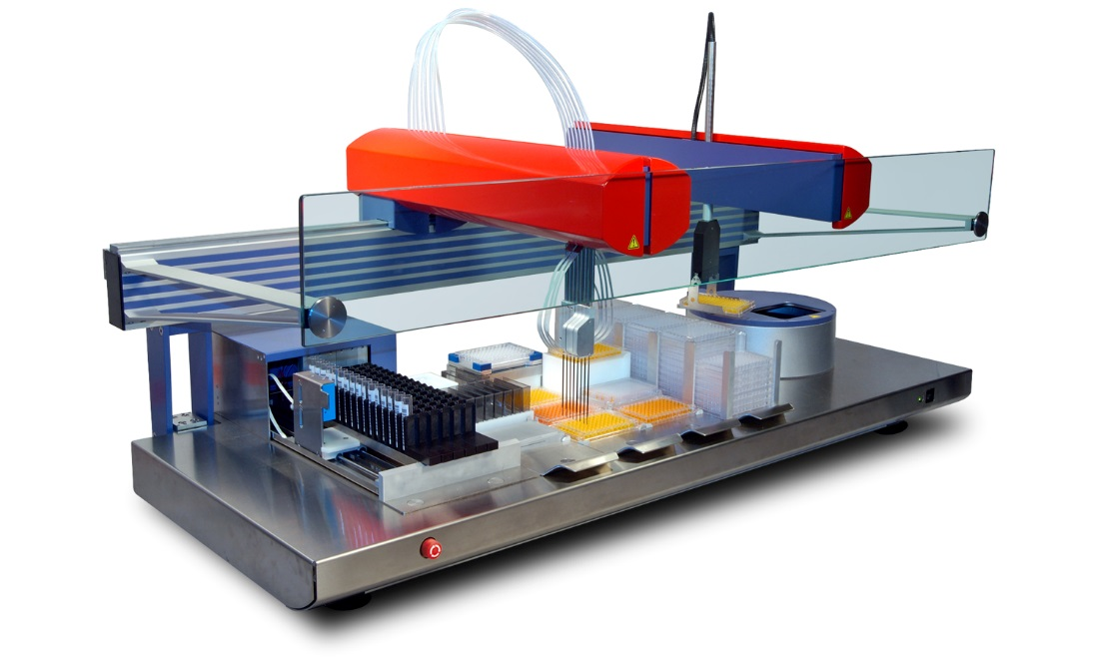
High Throughput setup
Standard, a 58 solvent-set is used to determine the HSP
Samples, solid or liquid, are dosed using HT Robotics
The 58 screeningsolvents are added and mixtures are equilibrated overnight on a roller mixer
First line assessment is visually (dissolved/not)

Slide 9
One step further by analytical assessment
Sample
Polymer
Pigment or solid particles
Non-polymer
GPC with UV/ELSD/RI
Lumisizer (sedimentation rate)
UV-active
Non UV-active
LCMS
HPLC
UV-VIS
GC(MS)
HPLC-Corona of ELSD
Responses are ultimately scaled to scores 1 - 6

Slide 10
Example 1 : UV-curable inkjet ink
Problems observed with PY150, PV19/PR202 mix 2 and PV19 dispersions : bad ratio pigmentophile/matrixophile
None of the dispersions are stable in VEEA matrix : marginal higher RED for matrixophilic part : improper balance pigmentophile/matrixophile ?

Slide 11
Example 2 : Water based inkjet ink
Issues with all colors and Dispersant 1, except for PB15:3 and PY13 : too low affinity of pigmentophile towards pigments.
All pigments well dispersed by Dispersant 2, although stability issues observed (viscosity increase) with magenta pigments and black : ratio pigmentophile/matrixophile is highest

Slide 12
Example 3 : Water based inkjet ink with additives
Issues observed with Yellow and Black ink, in combination with PEG600 : higher affinity of pigments for pigmentophilic compared to matrixophilic part.

Slide 13
Example 4 : UV-curable ink : Prototype
Issues Black ink : Not stable : Bad balance between pigmentophilic and matrixophilic moieties for Black
Stability issues for VEEA and Miramer M600 : higher affinity for pigmentophilic then matrixophilic part

Slide 14
Conclusions
For 18 studied cases or issues in inkjet-ink development, 14 could be explained by calculating the RED’s between the components.
Most issues were due to an improper matrixophilic & pigmentophilic balance of the dispersants.
High Throughput HSP determinations are an indispensible tool in qualifying interactions between different components.
We offer our HT-HSP services to 3th parties.
You can find us at : http://www.agfa-labs.com

